Slide 1

Chapter 25
Multimedia
TCP/IP Protocol Suite
Copyright © The McGraw-Hill Companies, Inc. Permission required for reproduction or display.

Slide 2
OBJECTIVES:
To show how audio/video files can be downloaded for future use or broadcast to clients over the Internet. The Internet can also be used for live audio/video interaction. Audio and video need to be digitized before being sent over the Internet.
To discuss how audio and video files are compressed for transmission through the Internet.
To discuss the phenomenon called Jitter that can be created on a packet-switched network when transmitting real-time data.
To introduce the Real-Time Transport Protocol (RTP) and Real-Time Transport Control Protocol (RTCP) used in multimedia applications.
To discuss voice over IP as a real-time interactive audio/video application.
TCP/IP Protocol Suite

Slide 3
OBJECTIVES (continued):
To introduce the Session Initiation Protocol (SIP) as an application layer protocol that establishes, manages, and terminates multimedia sessions.
To introduce quality of service (QoS) and how it can be improved using scheduling techniques and traffic shaping techniques.
To discuss Integrated Services and Differential Services and how they can be implemented.
To introduce Resource Reservation Protocol (RSVP) as a signaling protocol that helps IP create a flow and makes a resource reservation.
TCP/IP Protocol Suite

Slide 4
Chapter
Outline
25.1 Introduction
25.2 Digitizing Audio and Video
25.3 Audio/Video Compression
25.4 Streaming Stored
Audio/Video
25.5 Streaming Live
Audio/Video
25.6 Real-Time Interactive
Audio/Video
25.7 RTP
TCP/IP Protocol Suite
25.8 RTCP

Slide 5
Chapter
Outline
(continued)
25.9 Voice Over IP
25.10 Quality of Service
25.11 Integrated Services
25.12 Differentiated Services
TCP/IP Protocol Suite

Slide 6
25-1 INTRODUCTION
We can divide audio and video services into three broad categories: streaming stored audio/video, streaming live audio/video, and interactive audio/video, as shown in Figure 25.1. Streaming means a user can listen (or watch) the file after the downloading has started.
TCP/IP Protocol Suite

Slide 7
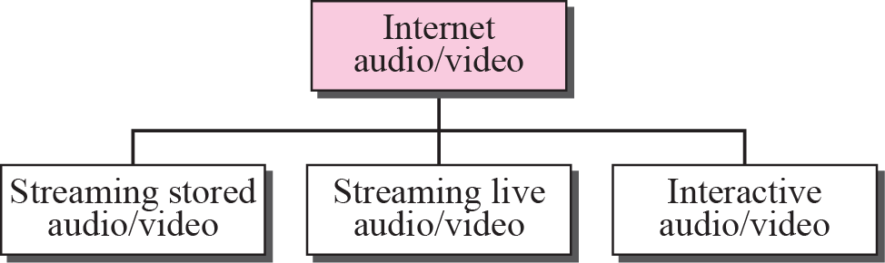
Figure 25.1 Internet audio/video
TCP/IP Protocol Suite

Slide 8

Note
Streaming stored audio/video refers to on-demand requests for compressed
audio/video files.
TCP/IP Protocol Suite

Slide 9
Note
Streaming live audio/video refers to
the broadcasting of radio and TV
programs through the Internet.
TCP/IP Protocol Suite

Slide 10
Note
Interactive audio/video refers to the use of the Internet for interactive
audio/video applications.
TCP/IP Protocol Suite

Slide 11
25-2 DIGITIZING AUDIO AND VIDEO
Before audio or video signals can be sent on the Internet, they need to be digitized. We discuss audio and video separately.
TCP/IP Protocol Suite

Slide 12
Topics Discussed in the Section
Digitizing Audio
Digitizing Video
TCP/IP Protocol Suite

Slide 13
Note
Compression is needed to send video over the Internet.
TCP/IP Protocol Suite

Slide 14
25-3 AUDIO AND VIDEO COMPRESSION
To send audio or video over the Internet requires compression. In this section, we first discuss audio compression and then video compression.
TCP/IP Protocol Suite

Slide 15
Topics Discussed in the Section
Audio Compression
Video Compression
Audio Compression
Audio compression can be used for speech or music. For speech, we need to compress a 64-kHz digitized signal; for music, we need to compress a 1.41 MHz signal.
Two categories of techniques are used for audio compression: predictive encoding and perceptual encoding.
Predictive Encoding
In predictive encoding, the differences between the samples are encoded instead of encoding all the sampled values.
This type of compression is normally used for speech. Several standards have been defined such as GSM (13 kbps), G.729 (8 kbps), and G.723.3 (6.4 or 5.3 kbps).
TCP/IP Protocol Suite

Slide 16
Topics Discussed in the Section
Audio Compression
Video Compression
Perceptual Encoding
MP3 The most common compression technique that is used to create CD-quality audio is based on the perceptual encoding technique. This type of audio needs at least 1.411 Mbps; this cannot be sent over the Internet without compression.
MP3 (MPEG audio layer 3), a part of the MPEG standard, uses this technique.
MP3 uses these two phenomena, frequency and temporal masking, to compress audio signals.
The technique analyzes and divides the spectrum into several groups. Zero bits are allocated to the frequency ranges that are totally masked.
A small number of bits are allocated to the frequency ranges that are partially masked. A larger number of bits are allocated to the frequency ranges that are not masked.
TCP/IP Protocol Suite

Slide 17
Video Compression
Video is composed of multiple frames. Each frame is one image. We can compress video by first compressing images.
Two standards are prevalent in the market. Joint Photographic Experts Group (JPEG) is used to compress images.
Moving Picture Experts Group (MPEG) is used to compress video.
Image Compression (JPEG)
If the picture is not in color (gray scale), each pixel can be represented by an 8-bit integer (256 levels).
If the picture is in color, each pixel can be represented by 24 bits (3 x 8 bits), with each 8 bits representing red, blue, or green (RBG). To simplify the discussion, we concentrate on a gray scale picture.
TCP/IP Protocol Suite

Slide 18
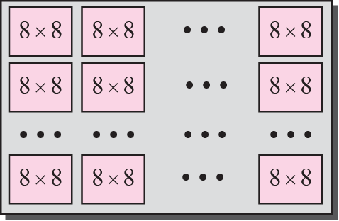
Figure 25.2 JPEG gray scale
In JPEG, a gray scale picture is divided into blocks of 8 x 8 pixels. The whole idea of JPEG is to change the picture into a linear set of numbers that reveals the redundancies. The redundancies (lack of changes) can then be removed by using one of the text compression methods.
TCP/IP Protocol Suite

Slide 19
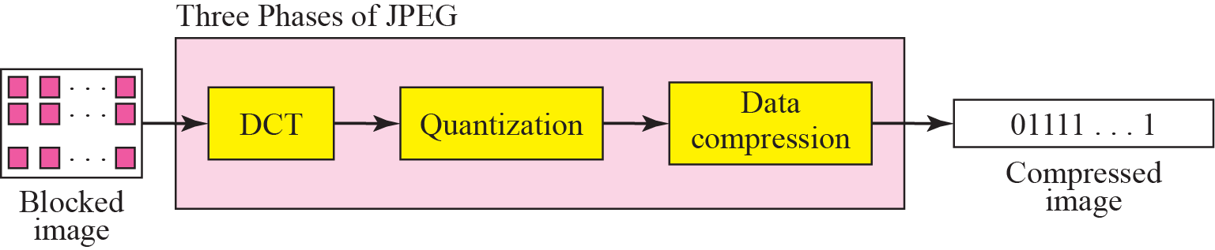
Figure 25.3 JPEG process
Quantization
The values in DCT are quantized to reduce the number of bits needed for encoding.
Here, we divide the number by a constant and then drop the fraction. This reduces the required number of bits even more.
In most implementations, a quantizing table (8 x 8) defines how to quantize each value. The divisor depends on the position of the value in the T table.
This is done to optimize the number of bits and the number of Os for each particular application.
Note that the only phase in the process that is not reversible is the quantizing phase.
TCP/IP Protocol Suite

Slide 20
The Discrete Cosine Transform (DCT) is a key technique used in video compression to efficiently reduce the amount of data needed to store or transmit video.
It works by converting video data from the spatial domain (pixels) to the frequency domain, where information about different frequencies (spatial patterns) is represented.
DCT achieves compression by discarding higher frequency components that are less visually important, and then reassembling the image from the remaining, lower-frequency component
TCP/IP Protocol Suite

Slide 21
Dividing into Blocks: Video frames are divided into smaller blocks, typically 8x8 or 16x16 pixels, for processing.
Converting to Frequency Domain: DCT transforms each block of pixels into a set of frequency coefficients. This process decomposes the signal into a sum of cosine functions of different frequencies.
Energy Compaction: DCT concentrates most of the image's energy into a few low-frequency coefficients. These coefficients represent the major visual features of the image.
Quantization and Compression: High-frequency coefficients, which represent fine details, are often discarded or quantized to a limited number of values to reduce the data size. This is where some loss of quality can occur.
Inverse DCT: When the compressed data is decoded, the inverse DCT is used to convert the frequency domain data back into the spatial domain, creating the reconstructed image.
TCP/IP Protocol Suite

Slide 22
Figure 25.3 JPEG process
We lose some information here that is not recoverable.
As a matter of fact, the only reason that lPEG is called lossy compression is because of this quantization phase.
Compression
After quantization, the values are read from the table, and redundant Os are removed. However, to cluster the Os together, the table is read diagonally in a zigzag fashion rather than row by row or column by column. The reason is that if the picture changes smoothly, the bottom right corner of the T table is all Os. Figure 29.7 shows the process.
TCP/IP Protocol Suite

Slide 23
Video Compression: MPEG
The Moving Picture Experts Group method is used to compress video.
In principle, a motion picture is a rapid flow of a set of frames, where each frame is an image. In other words, a frame is a spatial combination of pixels, and a video is a temporal combination of frames that are sent one after another.
Compressing video means spatially compressing each frame and temporally compressing a set of frames.
Spatial Compression
The spatial compression of each frame is a picture that can be independently compressed.
Temporal Compression
In temporal compression, redundant frames are removed. When we watch television, we receive 50 frames per second.
However, most of the consecutive frames are almost the same. For example, when someone is talking, most of the frame is the same as the previous one except for the segment of the frame around the lips, which changes from one frame to another.
TCP/IP Protocol Suite

Slide 24
To temporally compress data, the MPEG method first divides frames into three categories: I-frames, P-frames, and B-frames.
I-frames
An intracoded frame (I-frame) is an independent frame that is not related to any other frame (not to the frame sent before or to the frame sent after).
They are present at regular intervals (e.g., every ninth frame is an I-frame). An I-frame must appear periodically to handle some sudden change in the frame that the previous and following frames cannot show.
Also, when a video is broadcast, a viewer may tune in at any time.
If there is only one I-frame at the beginning of the broadcast, the viewer who tunes in late will not receive a complete picture.
I-frames are independent of other frames and cannot be constructed from other frames.
TCP/IP Protocol Suite

Slide 25
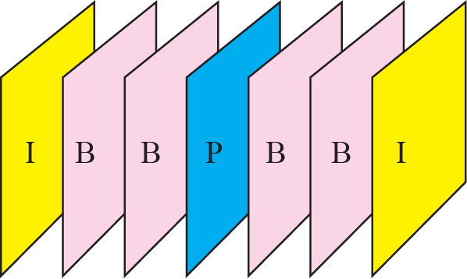
P-frames
A predicted frame (P-frame) is related to the preceding I-frame or P-frame. In other words, each P-frame contains only the changes from the preceding frame.
The changes, however, cannot cover a big segment. For example, for a fastmoving object, the new changes may not be recorded in a P-frame.
P-frames can be constructed only from previous 1- or P-frames. P-frames carry much less information than other frame types and carry even fewer bits after compression.
B-frames
A bidirectional frame (B frame) is related to the preceding and following I-frame or P-frame. In other words, each B-frame is relative to the past and the future. Note that a B-frame is never related to another B-frame.
Figure shows a sample sequence of frames.how I-, P-, and B-frames are constructed from a series of seven frames.
TCP/IP Protocol Suite

Slide 26
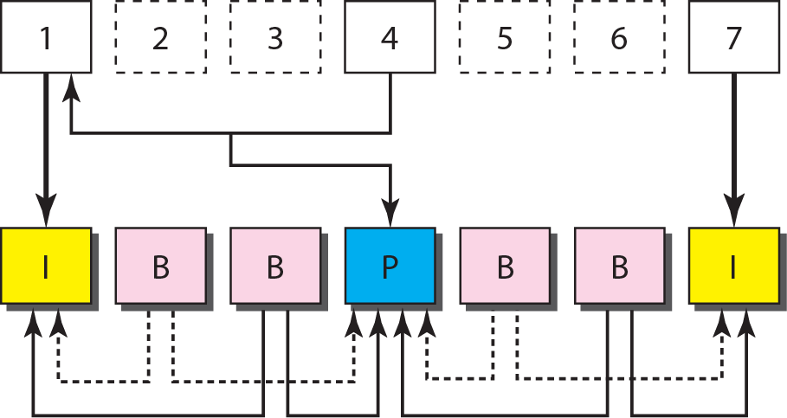
Figure 25.9 MPEG frame construction
Figure shows how I-, P-, and B-frames are constructed from a series of seven frames.
TCP/IP Protocol Suite

Slide 27
Figure 25.8 MPEG frames
TCP/IP Protocol Suite

Slide 28
25-4 STREAMING STORED
AUDIO/VIDEO
Now that we have discussed digitizing and compressing audio/video, we turn our attention to specific applications. The first is streaming stored audio and video. Downloading these types of files from a Web server can be different from downloading other types of files. To understand the concept, let us discuss three approaches, each with a different complexity.
TCP/IP Protocol Suite`1
`1

Slide 29
Topics Discussed in the Section
First Approach: Using a Web Server
Second Approach: Using a Web Server with Metafile
Third Approach: Using a Media Server
Fourth Approach: Using a Media Server and RTSP
TCP/IP Protocol Suite

Slide 30
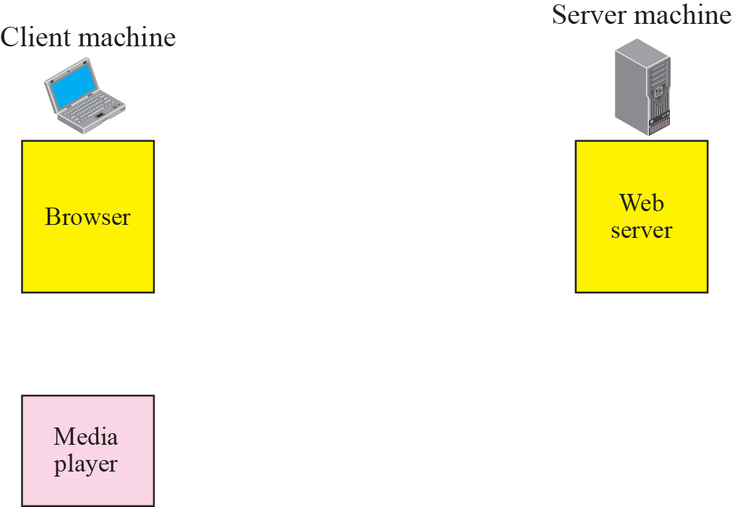


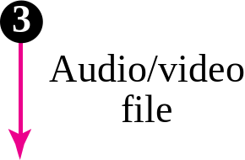
Figure 25.10 Using a Web server
TCP/IP Protocol Suite

Slide 31
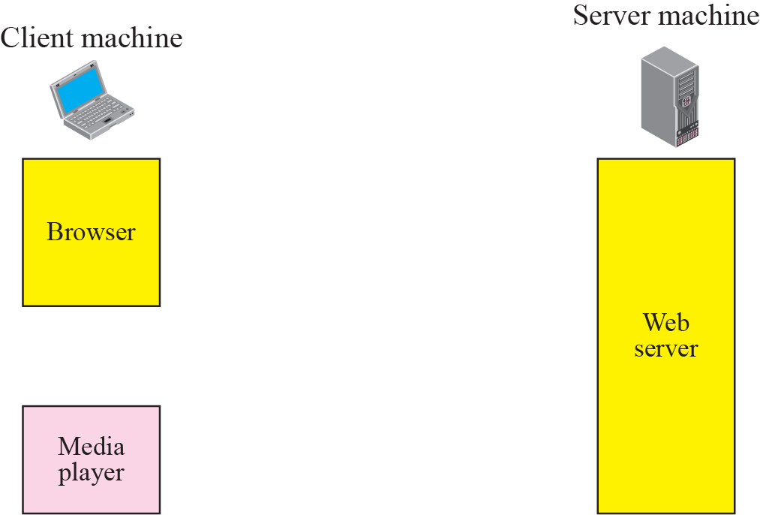


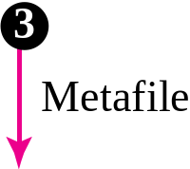

Figure 25.11 Using a Web server with a metafile
TCP/IP Protocol Suite

Slide 32
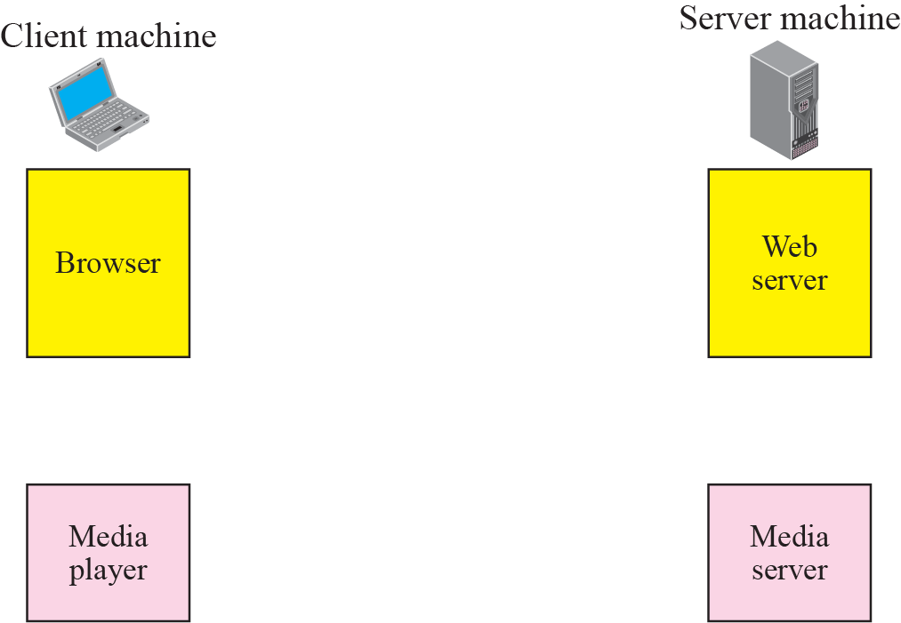
Figure 25.12 Using a media server
TCP/IP Protocol Suite

Slide 33
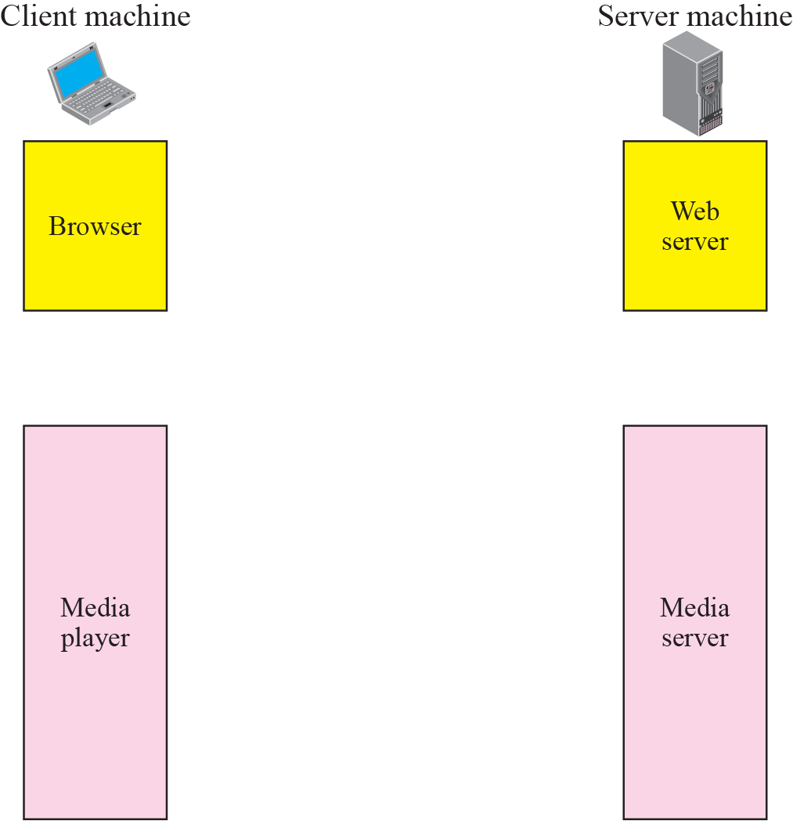


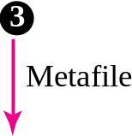







Figure 25.13 Using a media server and RSTP
TCP/IP Protocol Suite

Slide 34
25-5 STREAMING LIVE AUDIO/VIDEO
Streaming live audio/video is similar to the broadcasting of audio and video by radio and TV stations. Instead of broadcasting to the air, the stations broadcast through the Internet. There are several similarities between streaming stored audio/video and streaming live audio/video. They are both sensitive to delay; neither can accept retransmission. However, there is a difference. In the first application, the communication is unicast and on-demand. In the second, the communication is multicast and live.
TCP/IP Protocol Suite

Slide 35
25-6 REAL-TIME INTERACTIVE
AUDIO/VIDEO
In real-time interactive audio/video, people communicate with one another in real time. The Internet phone or voice over IP is an example of this type of application. Video conferencing is another example that allows people to communicate visually and orally.
TCP/IP Protocol Suite

Slide 36
Topics Discussed in the Section
Characteristics
TCP/IP Protocol Suite

Slide 37
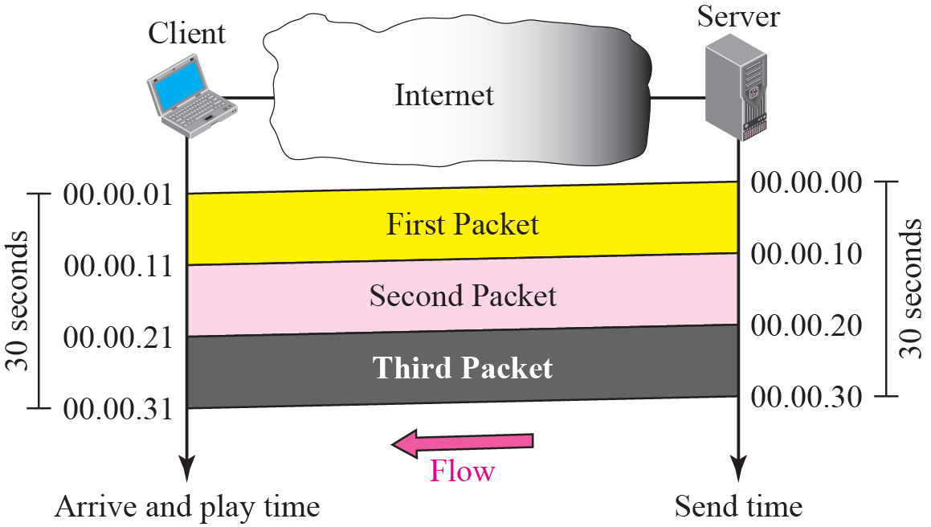
Figure 25.14 Time relationship
TCP/IP Protocol Suite

Slide 38
Note
Jitter is introduced in real-time data by the delay between packets.
TCP/IP Protocol Suite

Slide 39
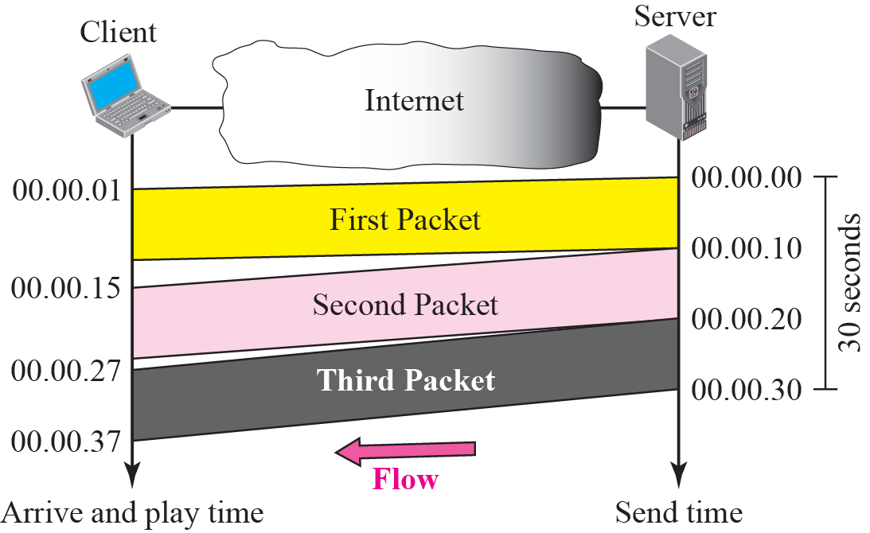
Figure 25.15 Jitter
TCP/IP Protocol Suite

Slide 40
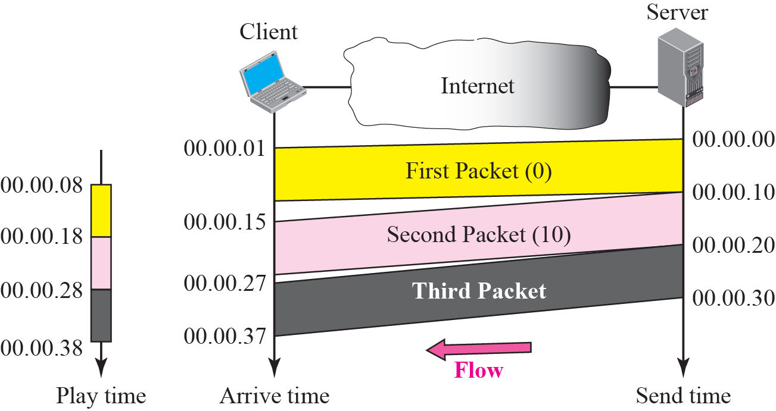
Figure 25.16 Timestamp
TCP/IP Protocol Suite

Slide 41
Note
To prevent jitter, we can timestamp the packets and separate the arrival time from the playback time.
TCP/IP Protocol Suite

Slide 42
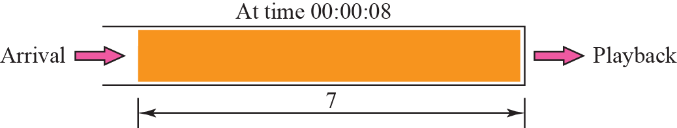
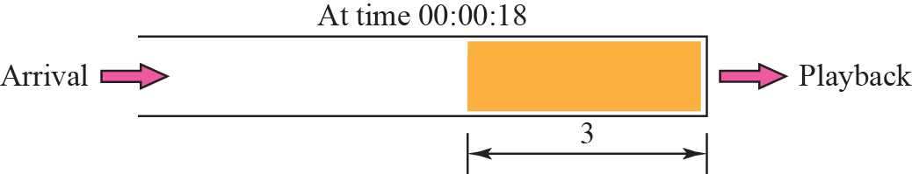
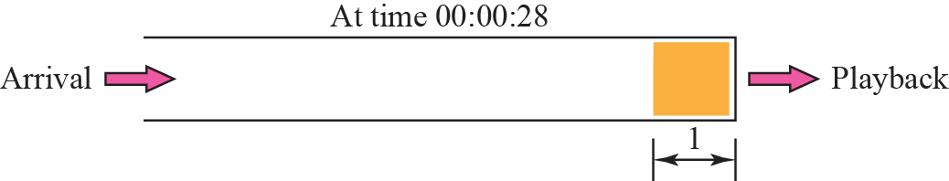
Figure 25.17 Playback buffer
TCP/IP Protocol Suite

Slide 43
Note
A playback buffer is required for
real-time traffic.
TCP/IP Protocol Suite

Slide 44
Note
A sequence number on each packet is required for real-time traffic.
TCP/IP Protocol Suite

Slide 45
Note
Real-time traffic needs the support of multicasting.
TCP/IP Protocol Suite

Slide 46
Note
Translation means changing the encoding of a payload to a lower
quality to match the bandwidth
of the receiving network.
TCP/IP Protocol Suite

Slide 47
Note
Mixing means combining several streams of traffic into one stream.
TCP/IP Protocol Suite

Slide 48
Note
TCP, with all its sophistication, is not suitable for interactive multimedia
traffic because we cannot allow retransmission of packets.
TCP/IP Protocol Suite

Slide 49
Note
UDP is more suitable than TCP for interactive traffic. However, we need
the services of RTP, another
transport layer protocol, to make
up for the deficiencies of UDP.
TCP/IP Protocol Suite

Slide 50
25-7 RTP
Real-time Transport Protocol (RTP) is the protocol designed to handle real-time traffic on the Internet. RTP does not have a delivery mechanism (multicasting, port numbers, and so on); it must be used with UDP. RTP stands between UDP and the application program. The main contributions of RTP are timestamping, sequencing, and mixing facilities.
TCP/IP Protocol Suite

Slide 51
Topics Discussed in the Section
RTP Packet Format
UDP Port
TCP/IP Protocol Suite

Slide 52
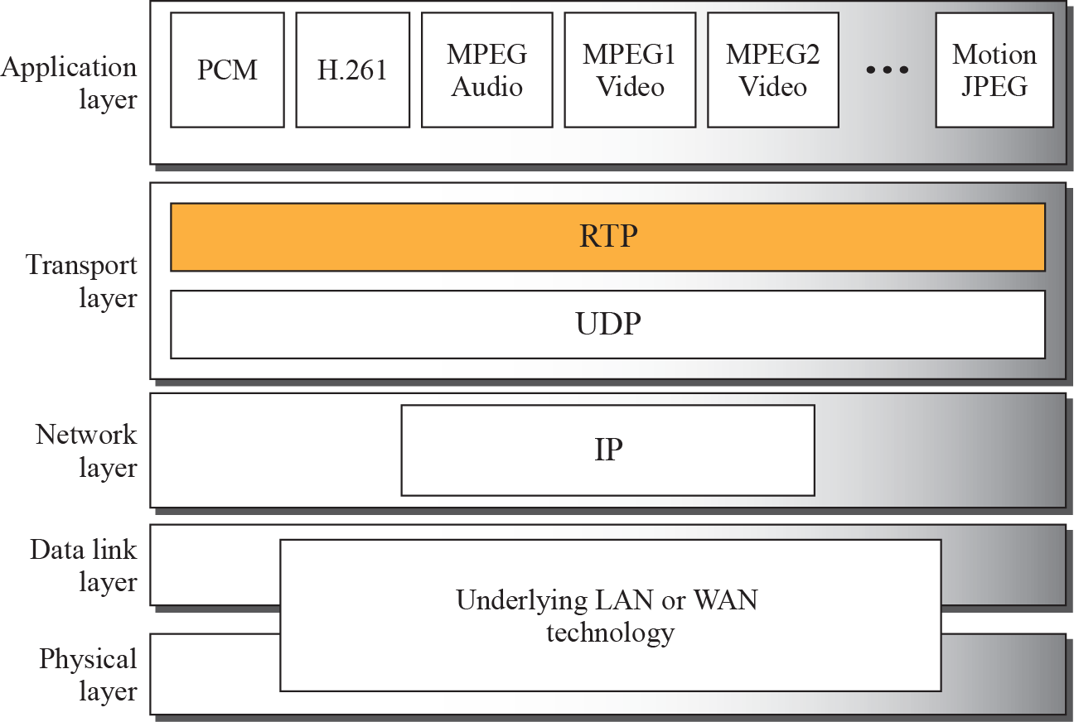
Figure 25.18 RTP packet header format
TCP/IP Protocol Suite

Slide 53
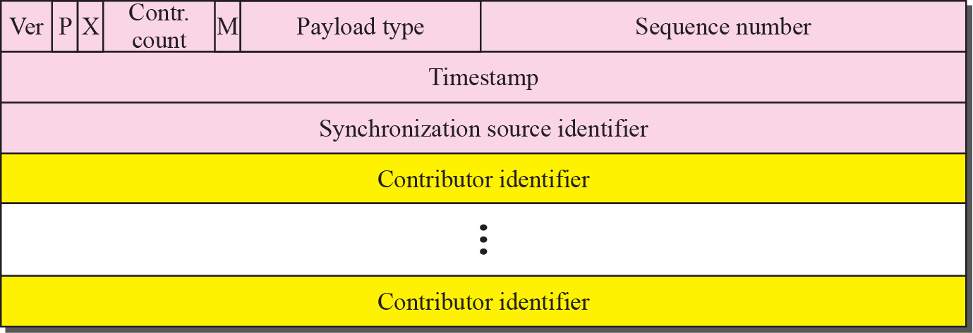
Figure 25.19 RTP packet header format
TCP/IP Protocol Suite

Slide 54
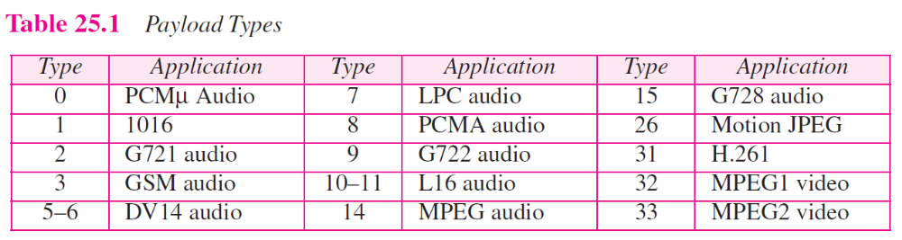
TCP/IP Protocol Suite

Slide 55
Note
RTP uses a temporary even-numbered UDP port.
TCP/IP Protocol Suite

Slide 56
25-8 RTCP
RTP allows only one type of message, one that carries data from the source to the destination. In many cases, there is a need for other messages in a session. These messages control the flow and quality of data and allow the recipient to send feedback to the source or sources. Real-Time Transport Control Protocol (RTCP) is a protocol designed for this purpose.
TCP/IP Protocol Suite

Slide 57
Topics Discussed in the Section
Sender Report
Receiver Report
Source Description Message
Bye Message
Application-Specific Message
UDP Port
TCP/IP Protocol Suite

Slide 58
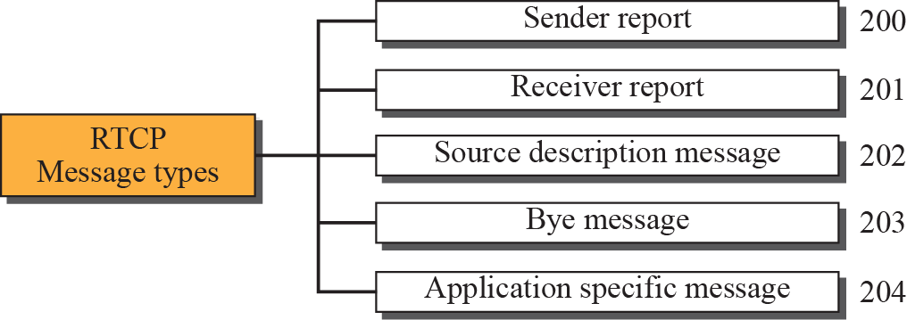
Figure 25.20 RTCP message types
TCP/IP Protocol Suite

Slide 59
Note
RTCP uses an odd-numbered UDP port number that follows the port number
selected for RTP.
TCP/IP Protocol Suite

Slide 60
25-9 VOICE OVER IP
Let us concentrate on one real-time interactive audio/video application: voice over IP, or Internet telephony. The idea is to use the Internet as a telephone network with some additional capabilities. Instead of communicating over a circuit-switched network, this application allows communication between two parties over the packet-switched Internet. Two protocols have been designed to handle this type of communication: SIP and H.323. We briefly discuss both.
TCP/IP Protocol Suite

Slide 61
Topics Discussed in the Section
SIP
H.323
TCP/IP Protocol Suite

Slide 62
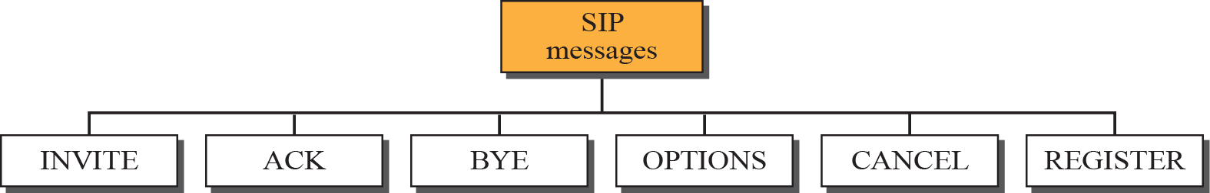
Figure 25.21 SIP messages
TCP/IP Protocol Suite

Slide 63
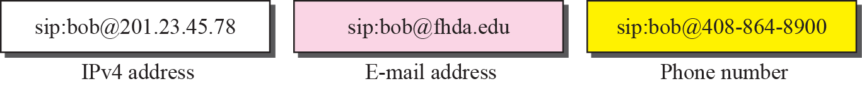
Figure 25.22 SIP formats
TCP/IP Protocol Suite

Slide 64
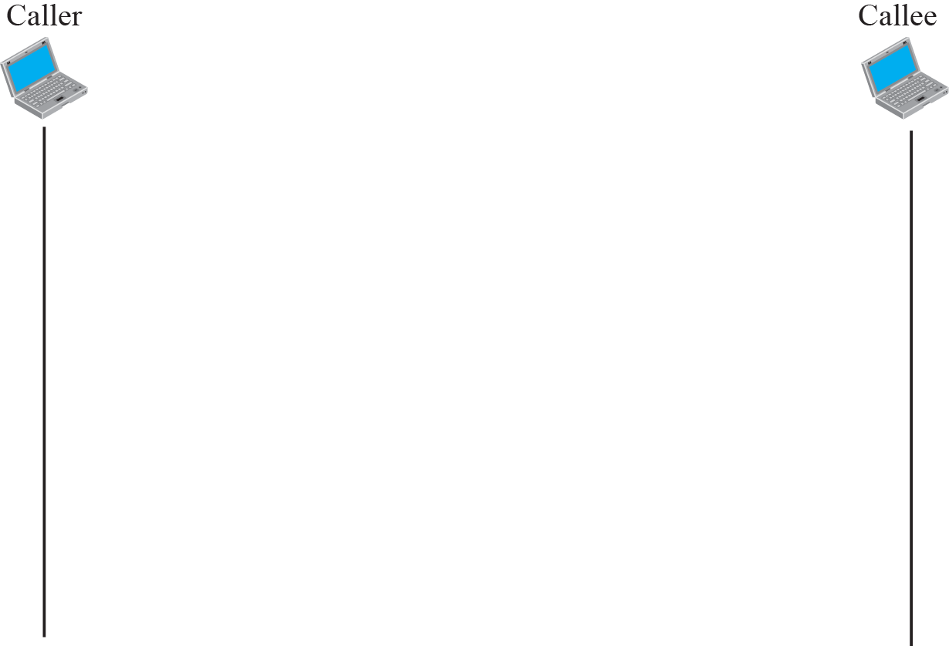
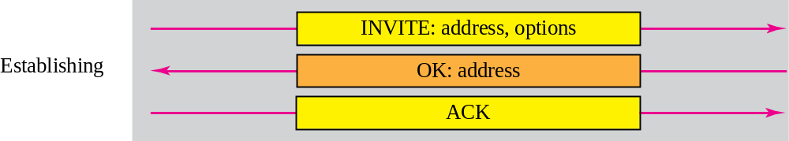
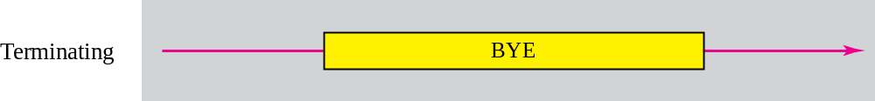
Figure 25.23 SIP simple session
TCP/IP Protocol Suite

Slide 65
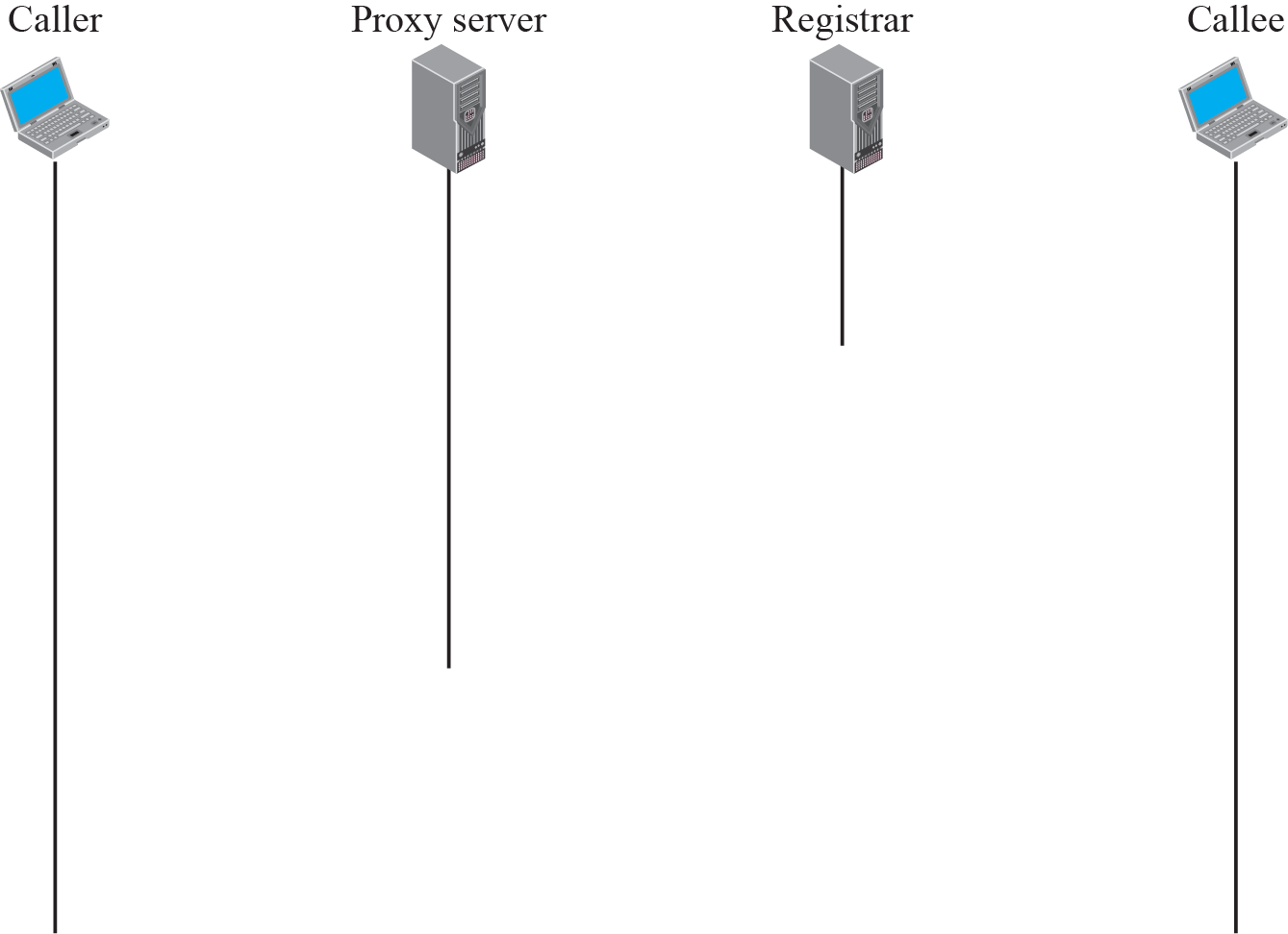






Figure 25.24 Tracking the callee
TCP/IP Protocol Suite

Slide 66
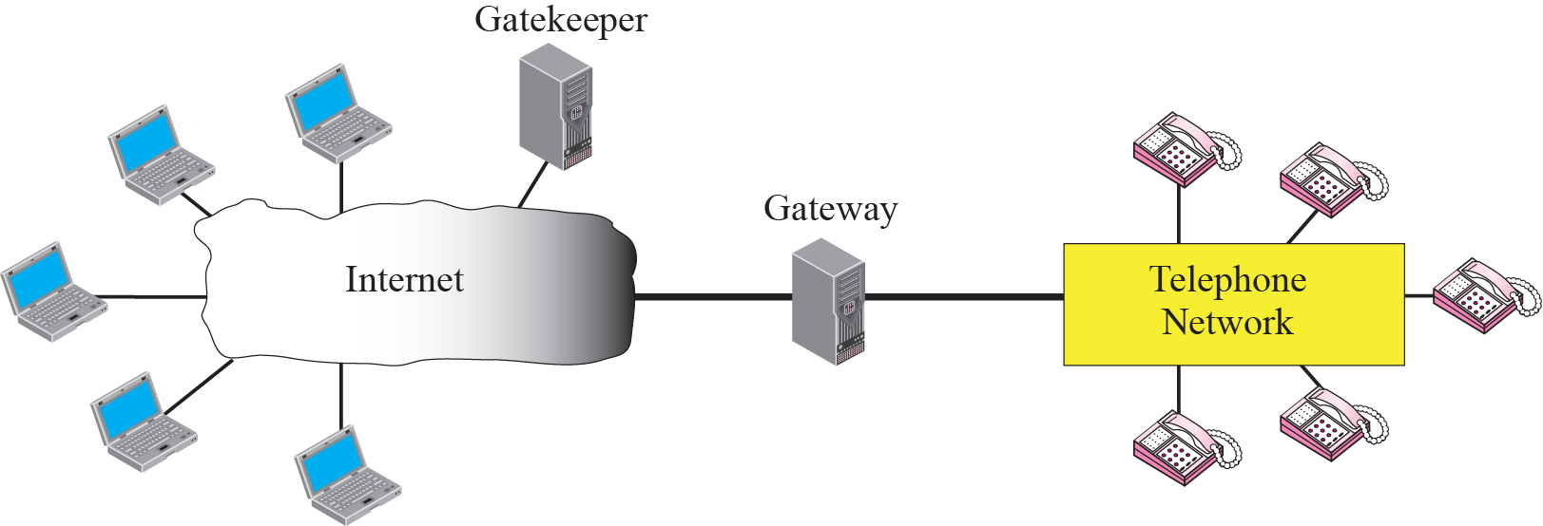
Figure 25.25 H.323 architecture
TCP/IP Protocol Suite

Slide 67
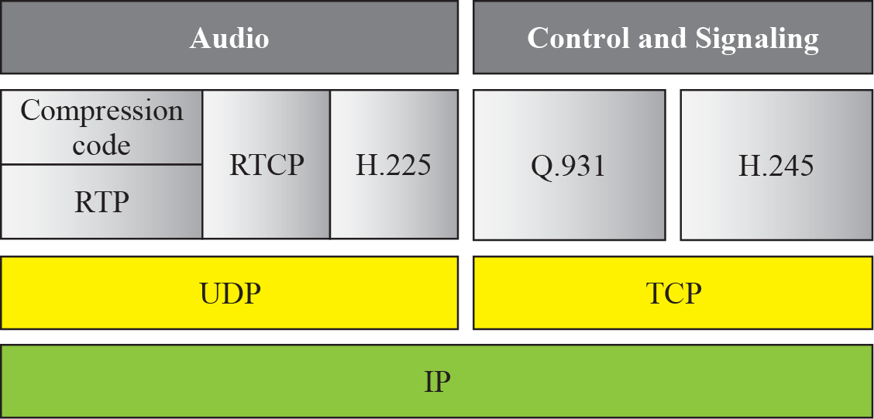
Figure 25.26 H.323 protocols
TCP/IP Protocol Suite

Slide 68
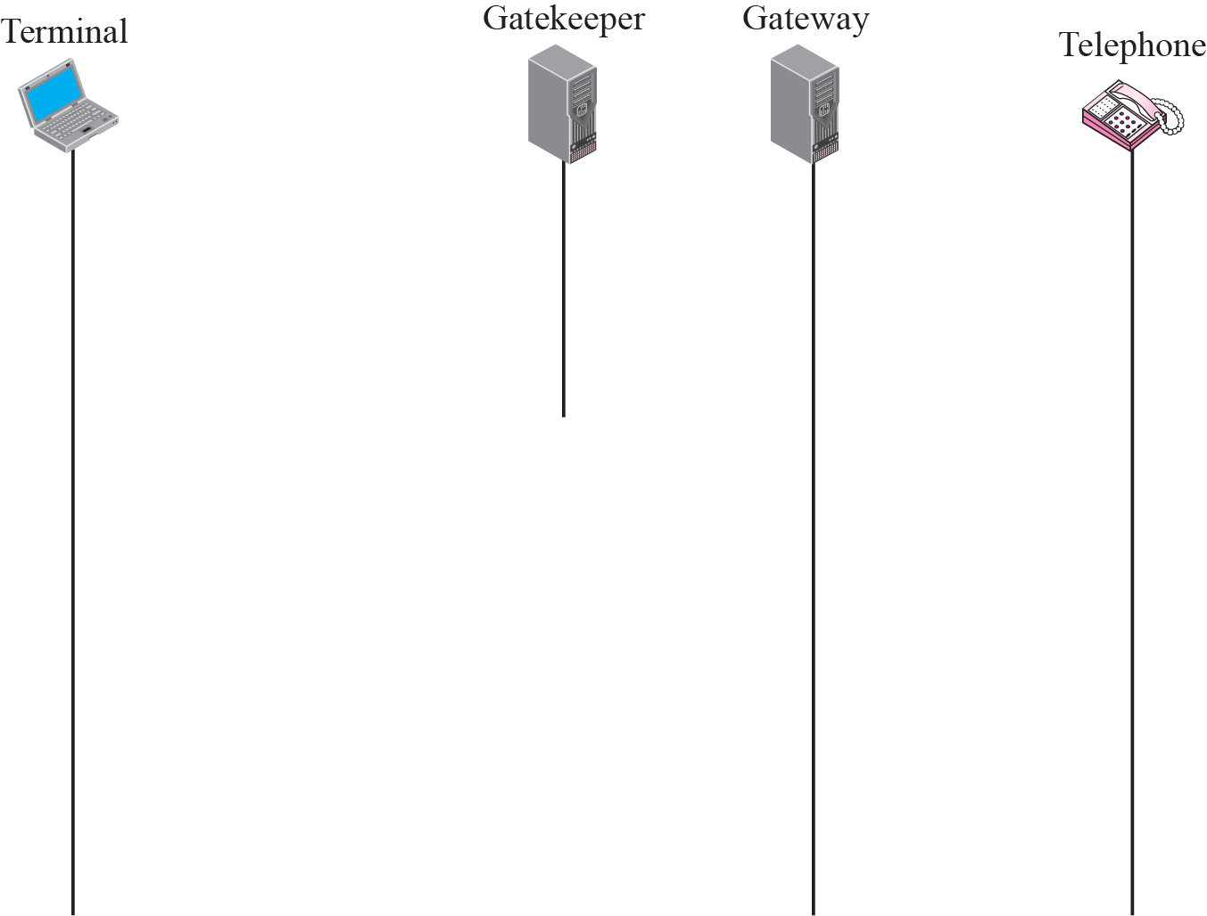



Figure 25.27 H.323 example
TCP/IP Protocol Suite

Slide 69
25-10 QUALITY OF SERVICE
Quality of service (QoS) is an internetworking issue that has been discussed more than defined. We can informally define quality of service as something a flow of data seeks to attain. Although QoS can be applied to both textual data and multimedia, it is more an issue when we are dealing with multimedia.
TCP/IP Protocol Suite

Slide 70
Topics Discussed in the Section
Flow Characteristics
Flow Classes
Techniques to Improve QoS
Resource Reservation
Admission Control
TCP/IP Protocol Suite

Slide 71
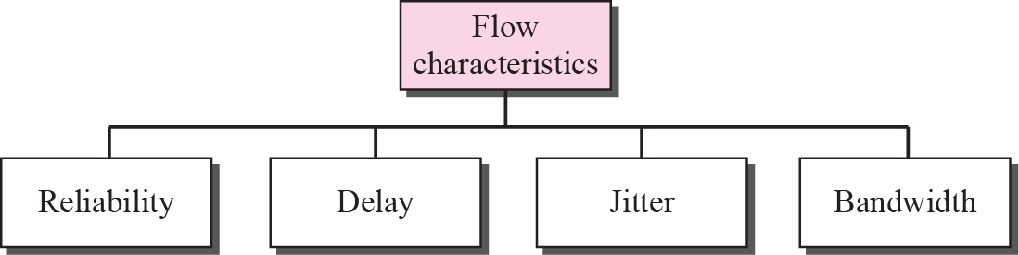
Figure 25.28 Flow characteristics
TCP/IP Protocol Suite

Slide 72
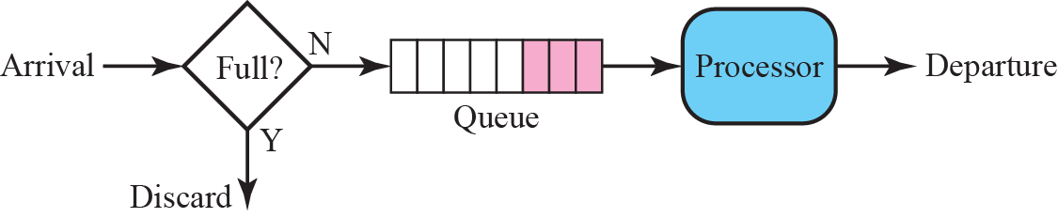
Figure 25.29 FIFO queues
TCP/IP Protocol Suite

Slide 73
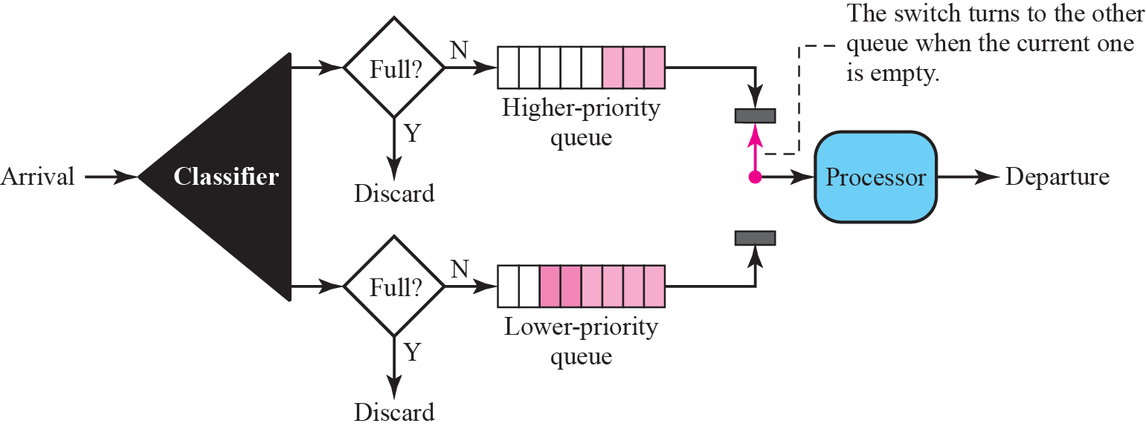
Figure 25.30 Priority queues
TCP/IP Protocol Suite

Slide 74
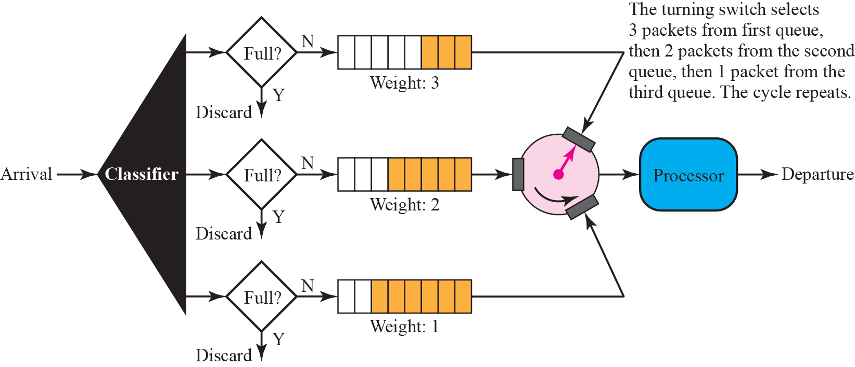
Figure 25.31 Weighted fair queuing
TCP/IP Protocol Suite

Slide 75
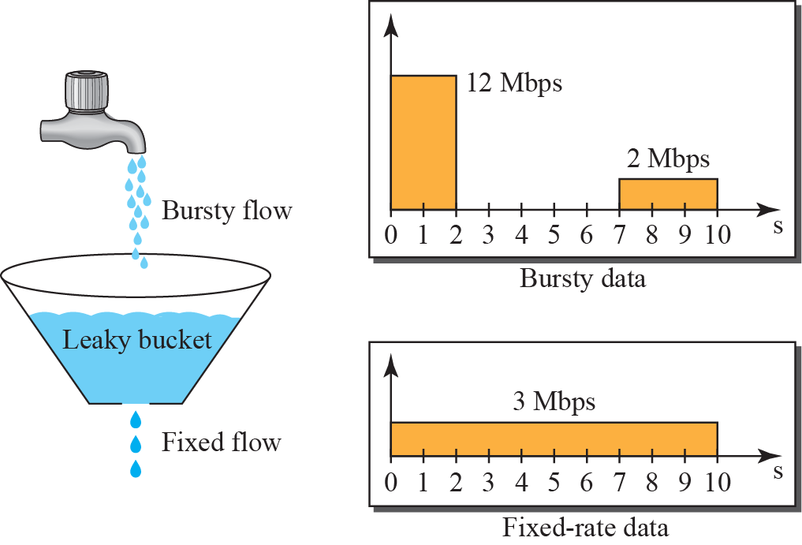
Figure 25.32 Leaky bucket
TCP/IP Protocol Suite

Slide 76
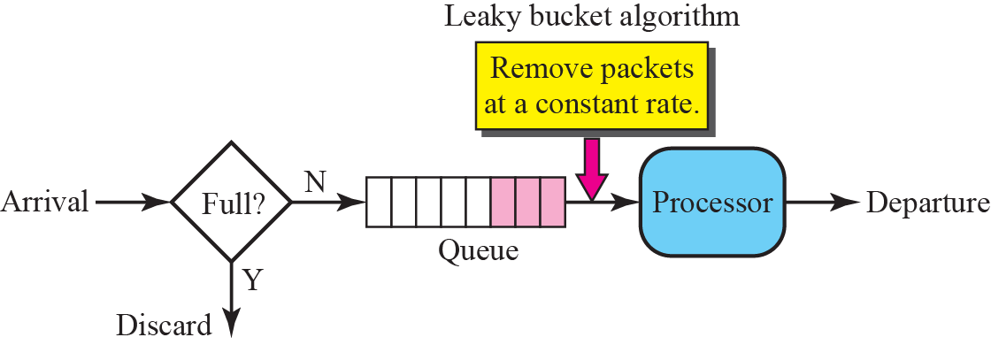
Figure 25.33 Leaky bucket implementation
TCP/IP Protocol Suite

Slide 77
Note
A leaky bucket algorithm shapes bursty traffic into fixed-rate traffic by
averaging the data rate.
It may drop the packets if the
bucket is full.
TCP/IP Protocol Suite

Slide 78
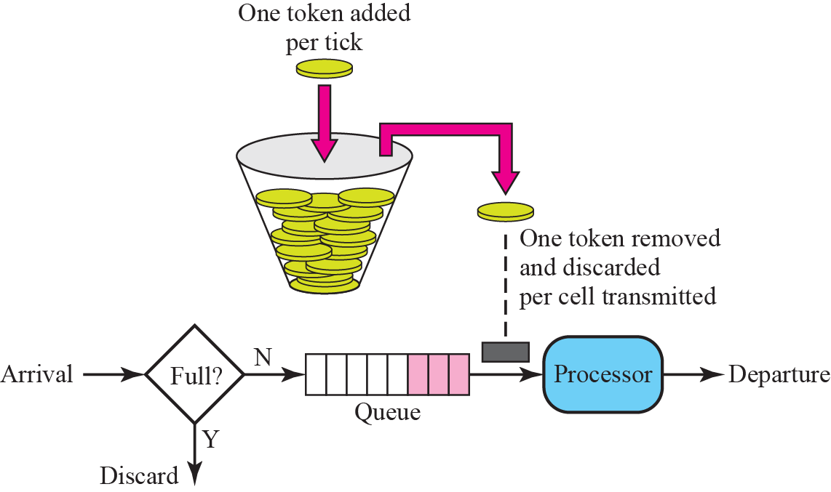
Figure 25.34 Token bucket
TCP/IP Protocol Suite

Slide 79
Note
The token bucket allows bursty traffic at a regulated maximum rate.
TCP/IP Protocol Suite

Slide 80
25-11 INTEGRATED SERVICES
IP was originally designed for best-effort delivery. This means that every user receives the same level of services. This type of delivery does not guarantee the minimum of a service, such as bandwidth, to applications such as real-time audio and video. Integrated Services, sometimes called IntServ, is a flow-based QoS model, which means that a user needs to create a flow, a kind of virtual circuit, from the source to the destination and inform all routers of the resource requirement.
TCP/IP Protocol Suite

Slide 81
Topics Discussed in the Section
Signaling
Flow Specification
Admission
Service Classes
RSVP
Problems with Integrated Services
TCP/IP Protocol Suite

Slide 82
Note
Integrated Services is a flow-based QoS model designed for IP.
TCP/IP Protocol Suite

Slide 83
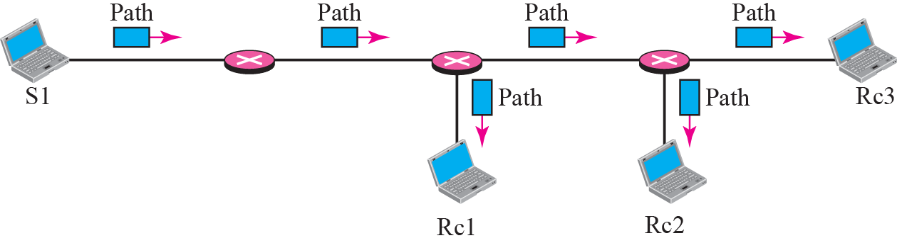
Figure 25.35 Path messages
TCP/IP Protocol Suite

Slide 84
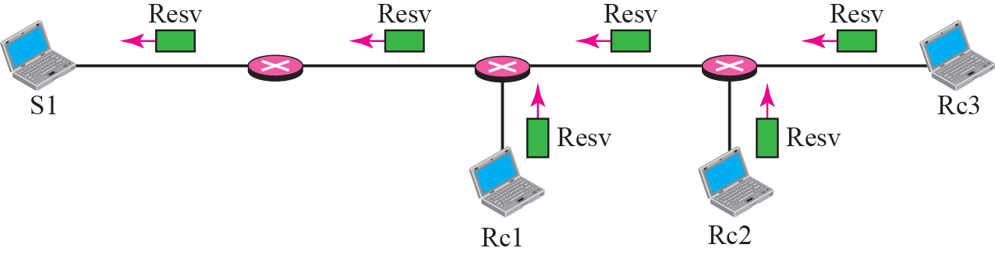
Figure 25.36 Resv messages
TCP/IP Protocol Suite

Slide 85
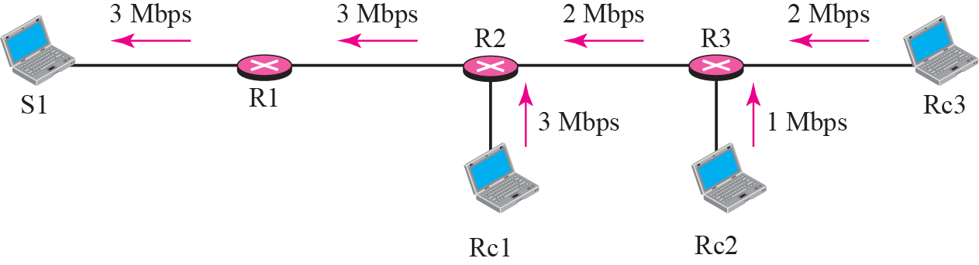
Figure 25.37 Reservation merging
TCP/IP Protocol Suite

Slide 86
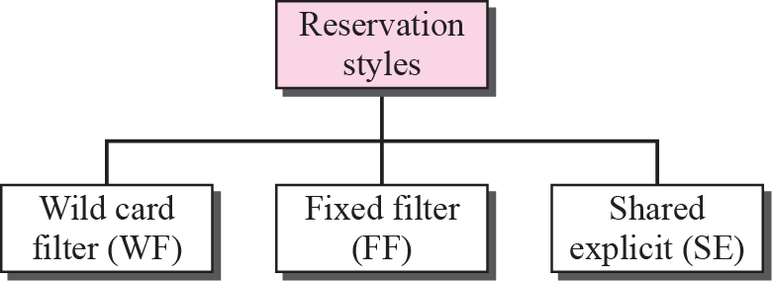
Figure 25.38 Reservation styles
TCP/IP Protocol Suite

Slide 87
25-12 DIFFERENTIATED SERVICES
Differentiated Services (DS or Diffserv) was introduced by the IETF (Internet Engineering Task Force) to handle the shortcomings of Integrated Services.
TCP/IP Protocol Suite

Slide 88
Topics Discussed in the Section
DS Field
TCP/IP Protocol Suite

Slide 89
Note
Differentiated Services is a class-based QoS model designed for IP.
TCP/IP Protocol Suite

Slide 90

Figure 25.39 DS field
TCP/IP Protocol Suite

Slide 91
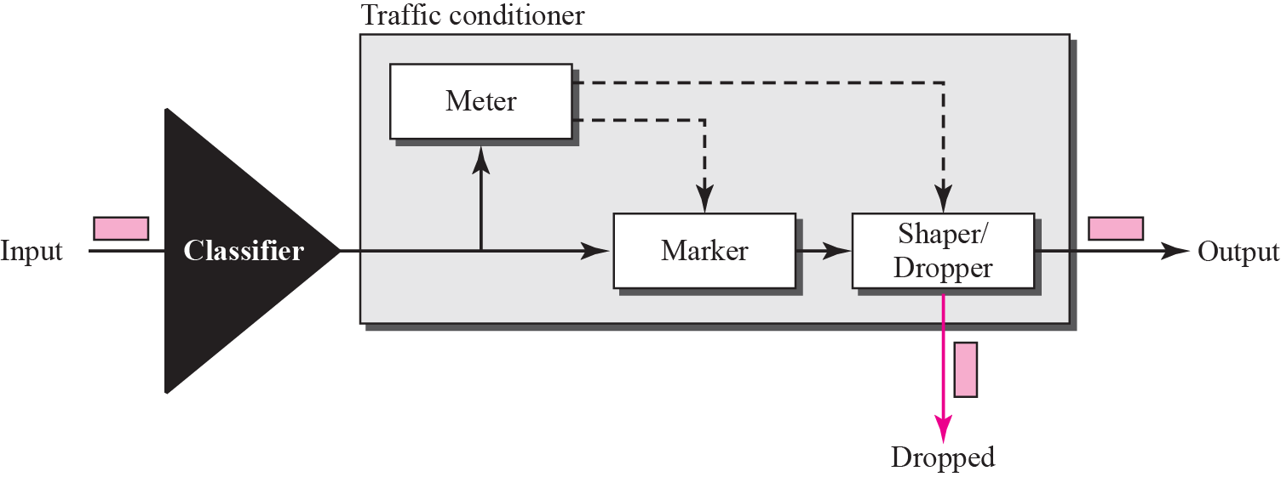
Figure 25.40 Traffic conditioner
TCP/IP Protocol Suite

